Slide 1
Theory of Automata (CSC- 402) Semester : Spring 2026 Credit Hours: 3

Slide 2
Course Objective
The objective of this course is to introduce the theory of automata through a set of abstract machines that serve as models for computation including finite automata, pushdown automata, and Turing machines. The course also examines the relationship between these automata and formal languages. In addition, the relation between theory and practical applications is also explored.

Slide 3
My Email ID : Sheeza.batool@bnu.edu.pk
Google Classroom Code : iwi3mqe7

Slide 4
General Rules
Keep account of your attendance
No Makeup for an announced quiz and assignments
Late assignments will not be accepted
No updating possible once the attendance is marked
Zero tolerance towards cheating and plagiarism

Slide 5
Division of Marks
Class Tests (3-4) 15
Assignments 10 (Takehome/InClass)
Project 05
Mid Term Test 25
Final Exam 45
Total 100

Slide 6
Books
Course Textbook
[A]. Introduction to Computer Theory by Daniel I.A. Cohen, 2nd Edition, Wiley.
[B]. Introduction to Languages and Theory of Computation by J. C. Martin, 4th Edition, y McGraw-Hill.

Slide 7
Course Objective
To have a clear understanding of automata theory concepts.
To understand that regular and context free languages are useful models for many important kinds of hardware and software.
To be able to understand the use of regular and context free languages in solving problems such as lexical analysis, text processing etc.

Slide 8
Theory of Automata Course
Lecture 1

Slide 9
CHAPTER 1
Overview

Slide 10
Introduction (Theory of Computation)
One of the most fundamental courses of computer science
It is mainly about what kind of things you can really compute mechnaically, how fast and how much space does it take to do so
For example, Consider a binary string that ends with 0
11010110

Slide 11
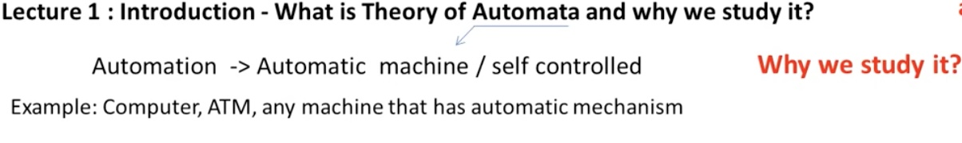
Introduction

Slide 12
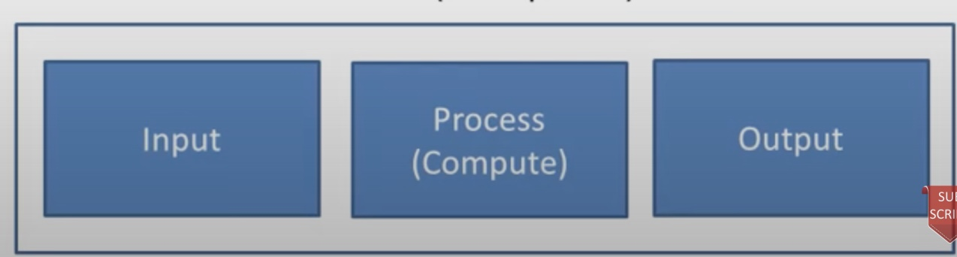
Introduction

Slide 13
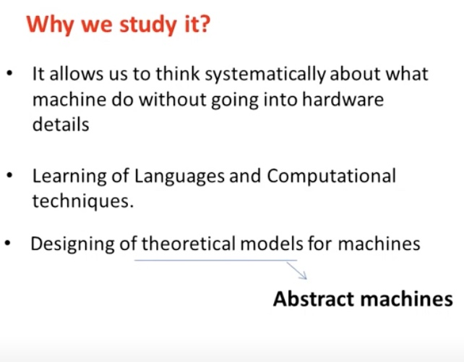
Why to Study?

Slide 14

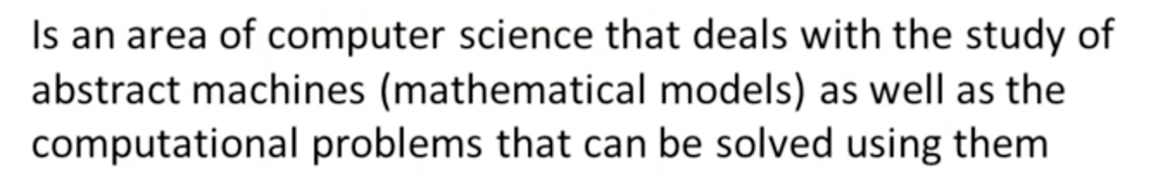
States

Slide 15
Introduction
Different names
Theory of Automata
Automata Theory
TTheory of Computer Science
Theory of Computation
Computer Theory

Slide 16
Let’s get started with...
Layers

Slide 17
Logic
Undecidable
Turing Machine
CFL
Context Free Language
FSM
Finite state machine

Slide 18
Power of Automata
Finite
Automata
Pushdown
Automata
Turing
Machine
Less power
More power
Solve more
computational problems

Slide 19
Language
Alphabet
String
Word
Language

Slide 20
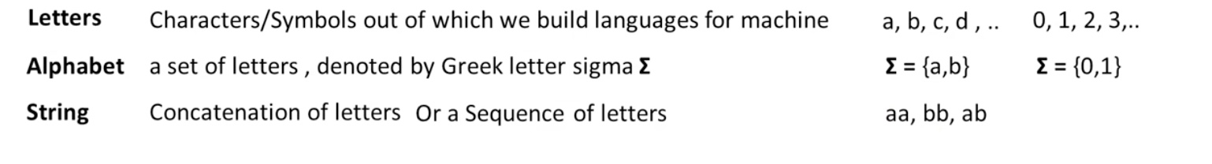
Language
symbols/

Slide 21
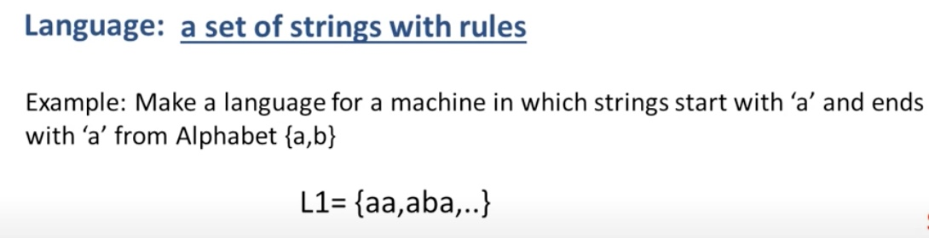
Language

Slide 22

Empty String
String that has no symbol is an empty string.
It is also known as Null String
It is denoted by
Its length is zero(0)

Slide 23
Length of a String
It is the number of symbols in a string
It is denoted by |s|

Slide 24
Reverse of String
It is obtained by writing symbols of string in reverse order
It is denoted by Rev(s) or S^{r} or Reverse(s)
Example : s= abab
What is the reverse of a string?
Rev(s)=baba

Slide 25
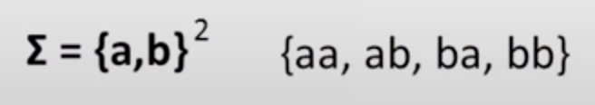
Power of Alphabet
It determines that the strings made from alphabet will be of length equal to power of alphabet

Slide 26
Power of Alphabet
Explain carefully:
Σ² = all strings of length 2.
If Σ = {a,b}
Σ¹ = {a,b} Σ² = {aa, ab, ba, bb} Σ³ = {aaa, aab, aba, abb, baa, bab, bba, bbb}
Formula: If |Σ| = k Then |Σⁿ| = kⁿ

Slide 27
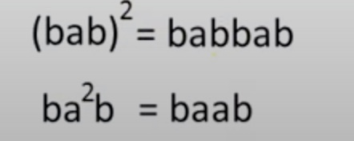
Power of String
It determines the length of the string

Slide 28
Power of String
It determines the length of the string
If s = ab
s² = abab s³ = ababab s⁰ = ε
Important: Any string power 0 = ε

Slide 29
End of Lecture

